Slide 1



Jammu-Kashmir Rural Connectivity: Mountain Top LiFi Laser 5G Internet
This visionary project aims to bring high-speed internet connectivity to the remote, mountainous regions of Jammu and Kashmir through the innovative use of LiFi laser technology and 5G networks, bridging the digital divide for rural communities.
Parveet Kumar

Slide 2


Bridging the Connectivity Gap in Mountainous Terrain
Enhancing Accessibility
Reducing Costs
The project focuses on improving internet accessibility in hard-to-reach mountainous areas, providing vital digital services to underserved communities.
By leveraging LiFi technology, I aim to lower the costs of internet service delivery in these remote regions, making it more affordable for local residents.
Overcoming Challenges
I have tackled logistical hurdles, such as powering LiFi transmitters in extreme environments and strategically positioning them for optimal connectivity.

Slide 3
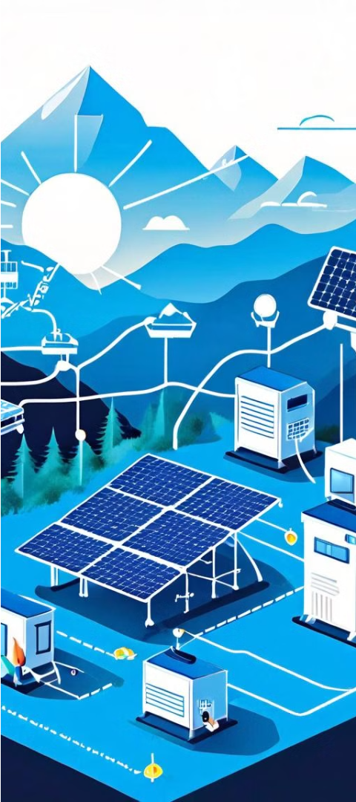
Pathway to Connectivity
1
Power Source
Integrating solar panels and battery systems to meet the energy requirements of LiFi transmitters.
2
Transmitter Placement
Strategically positioning LiFi transmitters based on geographical data and terrain analysis for maximum coverage.
3
Connectivity Solution
Deploying the LiFi laser technology to provide high-speed, reliable internet access to remote mountain communities.

Slide 4
Powering the Peak Process
Solar-Powered Solutions
Thermal Management
Resilient Infrastructure
The project leverages solar panels to generate the necessary power of about 100 W - 200 W for LiFi transmitters, ensuring a sustainable and reliable energy source.
Innovative thermal-resistant chambers with solar-heated cabins and thermally isolating foam maintain battery functionality in low-temperature environments, enabling continuous operation.
The system is designed to withstand the harsh weather conditions of the mountainous terrain, providing uninterrupted internet connectivity to remote communities.

Slide 5




Conquering Connectivity Challenges
Terrain Analysis
Leveraging Google API determine the dominant downward slope of mountainous terrains, ensuring optimal placement of communication infrastructure."
Utilizing Line-of-Sight Analysis
Strategically defining a search space to pinpoint the optimal peak location, integrating line-of-sight analysis for precision peak identification in remote areas.
Identifying Nearest Summit
"Exploring the search space to pinpoint the closest peak, optimizing the placement of transmitters and receivers for optimal connectivity in remote regions."

Slide 6

Charting the Future of Rural Connectivity
1
Better Tourism
2
Efficiency Optimization
3
Better Communication
Enhancing tourism by enabling reliable communication in remote Jammu and Kashmir, facilitating access to hidden mountain treasures and enriching trekking experiences.
Ongoing efforts to improve system efficiency and further optimize the technology will enhance the project's long-term sustainability.
This pioneering LiFi initiative addresses the digital divide, empowering rural communities and strengthening border security by providing swift and reliable communication in remote areas
Thank You

